Slide 1
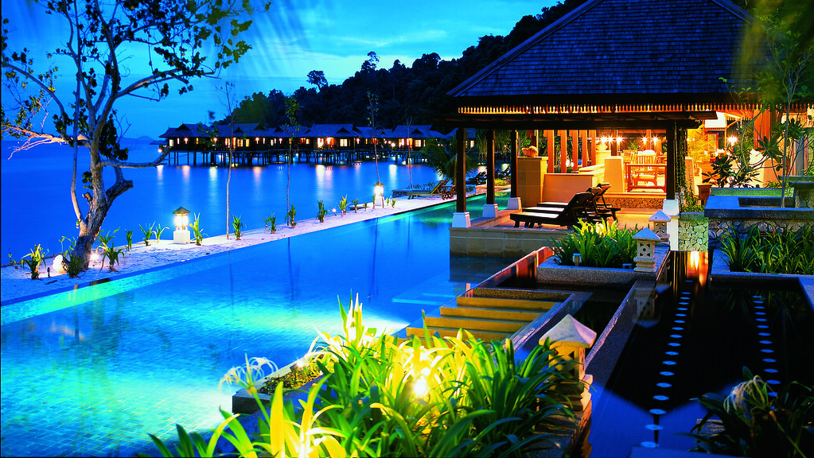
Atlantis, The Palm Hotel

Slide 2
PROBLEM STATEMENT
People planning vacations are looking for a resort that offers a variety of amenities and a good hotel to stay
Hotel management usually focuses only on room reservation management and does not manage other recreational events
To help customers find their best time with events such as dining, theatre, hotel, celebrations and other features, we created an app called Atlantis, The Palm Hotel

Slide 3
APPROACH
To create a centralized platform for to booking rooms including services such as manage celebrations, manage hotel, manage theatre, and manage restaurant
Users can request for a room, select a safari and car services of their choice. Theatre Manager will organize Music Band/ Comedian/ Magician. Celebration Manager will manage the events(Bdy, Wedding, Anniversary) Restaurant Manager will check on Delivery agent.

Slide 4
AREAS TO FOCUS
The Hotel management helps to improve the features of the hotel keeping in mind the demand
Customer demand is always our primary concern, and we focus on providing the right resources to our customers
Each Manager takes care of important functions to deliver best outcomes to customers

Slide 5
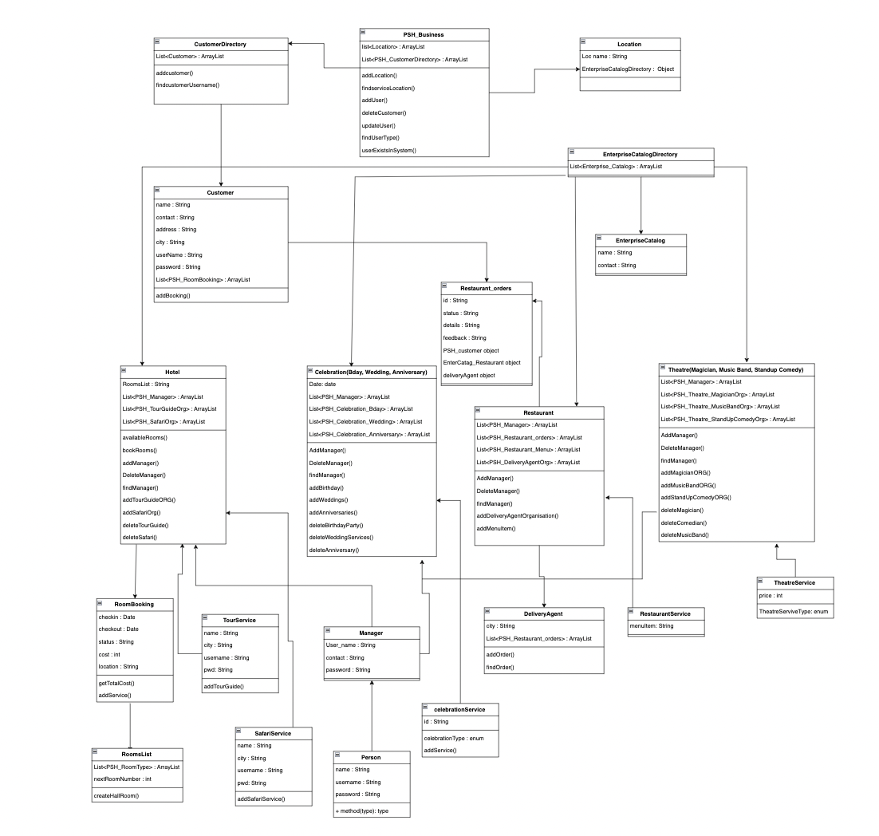
UML Diagram:

Slide 6
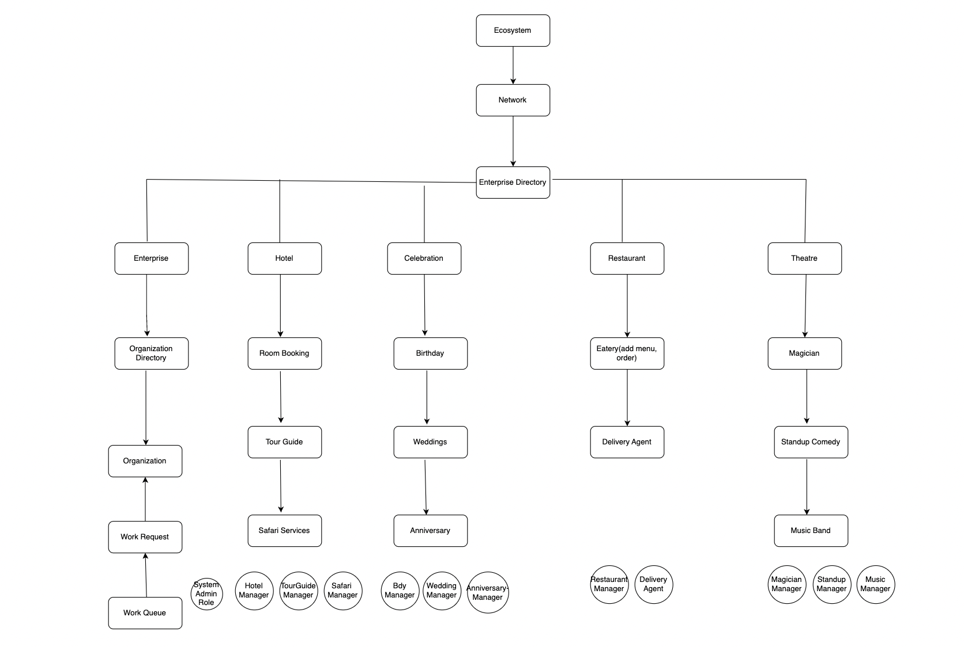
High level component Diagram:

Slide 7


